Slide 1
An Analysis of a Bounded Resource Search puzzle
Gopal Anantharaman, HP Inc.
Palo Alto, CA

Slide 2

History
First posed in Foundation Of Computer Science - FOCS 1980
Algorithms & Theory of Computation book has an algorithm( non-optimal)
Several variations were studied.
My paper, published in Arxiv.org (May 2004 ) – First paper to study the general variant solution using Dynamic Programming.
https://arxiv.org/abs/cs/0405110
Mathematics Magazine – ‘The Egg-Drop Numbers’ – Vol. 77. No . 5 (Dec., 2004), pp. 368-372. possible independent study with rigorous formal proof.
Several sites with solution – Applicability? Not realized, as much!

Slide 3
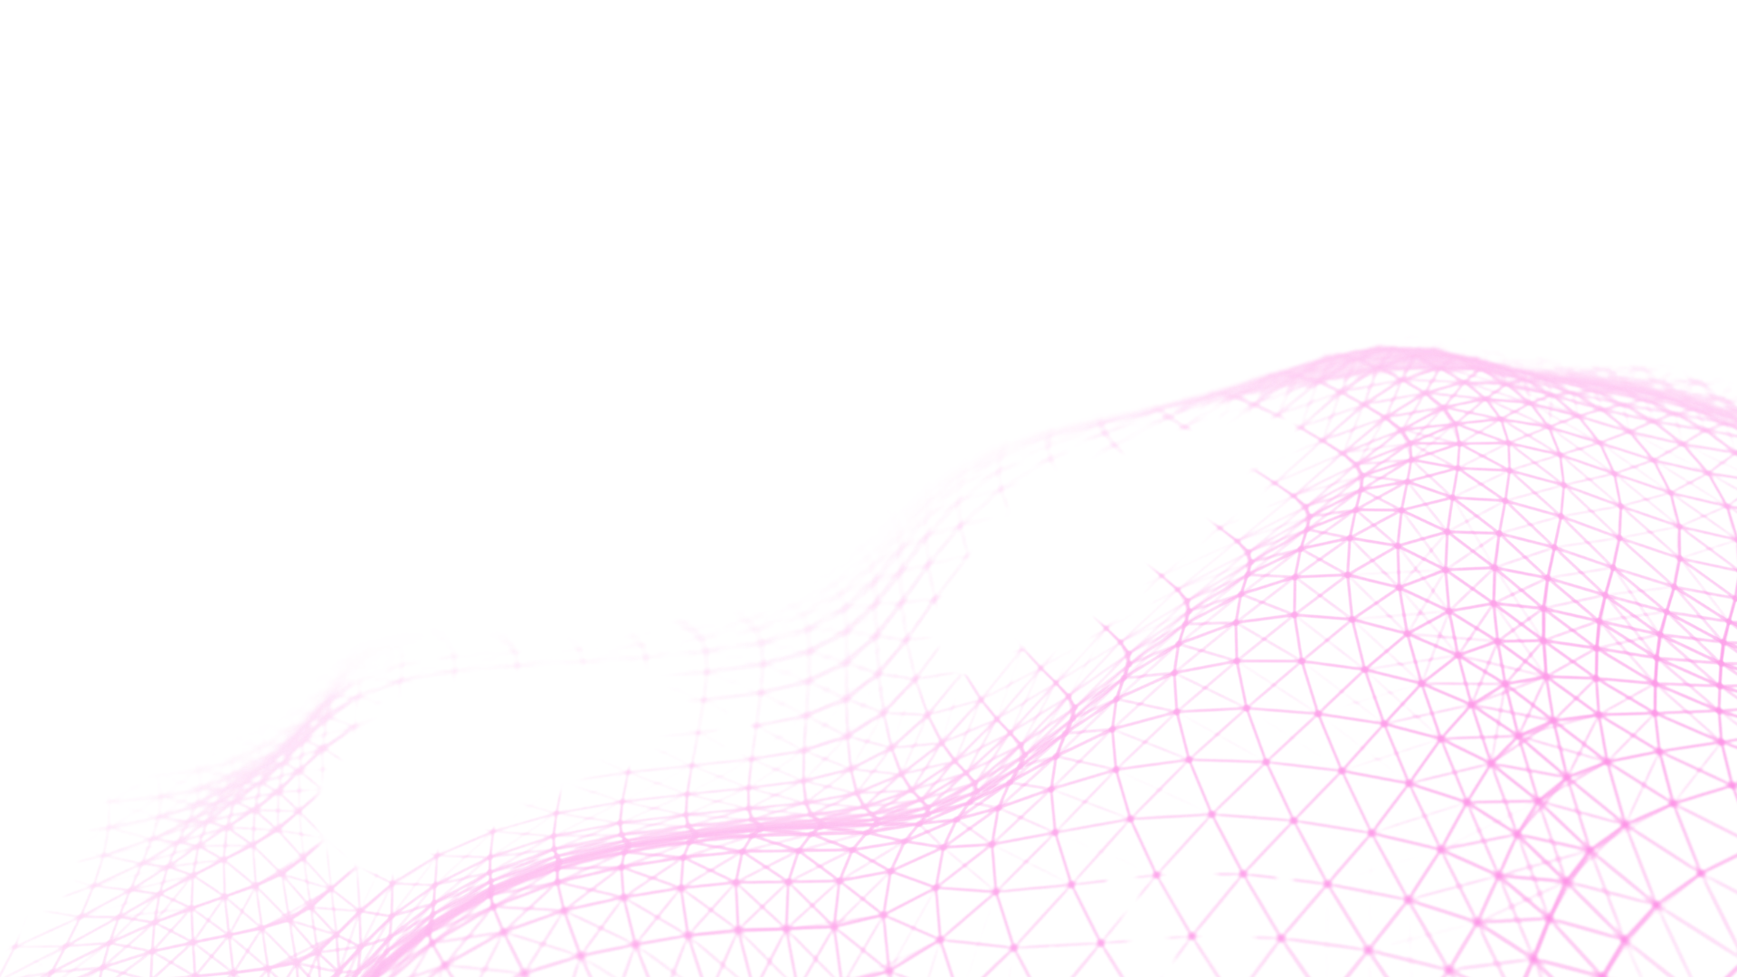

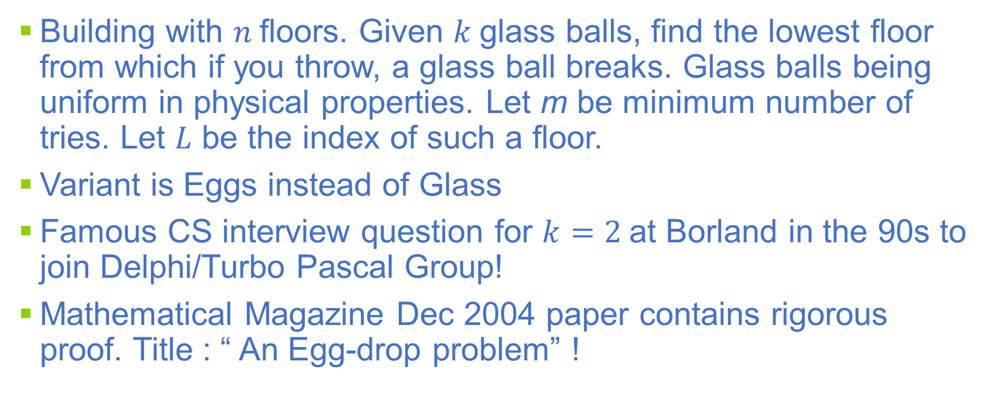
TAA SA deceivingly simple Puzzle
Building with $n$floors. Given $k$glass balls, find the lowest floor from which if you throw, a glass ball breaks. Glass balls being uniform in physical properties. Let m be minimum number of tries. Let $L$ be the index of such a floor.
Variant is Eggs instead of Glass
Famous CS interview question for $k=2$at Borland in the 90s to join Delphi/Turbo Pascal Group!
Mathematical Magazine Dec 2004 paper contains rigorous proof. Title : “ An Egg-drop problem” !

Slide 4


Main Result
For k = 2 , m = $\left\lceil \frac{\sqrt{8n+1}−1}{2}\right\rceil$is well known.
Main Result :
For any k, $1+\sum_{i=1}^{k}{\left(\begin{matrix}m−1 \\ i\end{matrix}\right)}<n≤\sum_{i=1}^{k}{\left(\begin{matrix}m \\ i\end{matrix}\right)}$

Slide 5

Proof for k =2
Proof using simple counting!
Let $\left\{p_{1},p_{2},p_{3}…p_{m}\right\}$ be the final set of floor indices where an attempt is made. Assuming, L exists and $p_{0}=0$.
Assume the ball did not break until $p_{i−1}$. Next attempt at $p_{i}$ the ball breaks. There are$m−ⅈ$ attempts left, $p_{i}$ - $p_{i−1}−1$ floors left, 1 ball left. Therefore, $m−ⅈ=p_{i}−p_{i−1}−1$.
Note that When $p_{m}$is the last floor, Total no. of floors - which is simply all the probed floors & floors between them i.e. $n=m+\sum_{i=1}^{m}{p_{i}}−p_{i−1}−1=m(m+1)/2$ applying previous eqn.
From which we get $m= \left\lceil \frac{\sqrt{8n+1}−1}{2}\right\rceil$.

Slide 6


Proof for any positive $k$
Proof using dynamic programming!
Suppose $\left\{p_{1},p_{2},p_{3}…p_{m}\right\}$ be the final set of floor indices where an attempt is made. Assuming, L exists and $p_{0}=0$.
Suppose there exists a function $P:ℤ^{+}X{ ℤ}^{+}→ℤ^{+}$ s.t.
$P\left(m,k\right)≥n>P(m−1, k)$ and
$P\left(0,i\right)=0=P(i,0)$
The maximum value of this function, using dynamic programming principles of optimal sub-problem, is .
$P\left(m,k\right)=m+ \sum_{i=1}^{m−1}{P\left(i,k−1\right)}$ ( Interesting variation is $P\left(m,k\right)=m +\prod_{i=1}^{m−1}{P\left(i, k−1\right)}$)

Slide 7


Proof for any positive $k$ contd…
So, $P\left(m−1,k\right)=m−1 + \sum_{i=1}^{m−2}{P\left(i,k−1\right)}$
Subtracting, we have the familiar,
$P\left(m,k\right)=1+$ $P\left(m−1,k\right)$ + $P\left(m−1,k−1\right)$
a non-irreducible Solution is,
$$P\left(m,k\right)= \sum_{j=1}^{k}{\left(\begin{aligned}m \\ j\end{aligned}\right)}$$
No Closed form!

Slide 8

So, for k=2
$\sum_{j=1}^{2}{\left(\begin{aligned}m \\ j\end{aligned}\right)}$ = $\left(\begin{aligned}m \\ 1\end{aligned}\right)$ + $\left(\begin{aligned}m \\ 2\end{aligned}\right)$
Just set this equal to n. Solve for m
$\frac{m!}{\left(m−1\right)!}$ + $\frac{m!}{\left(m−2\right)!}$ = $m+\frac{m(m−1)}{2}⇒\frac{m(m+1)}{2}=n$, same as before!
If k =m, We have now,
$$\sum_{j=0}^{m}{\left(\begin{aligned}m \\ j\end{aligned}\right)=2^{m}= \sum_{j=1}^{m}{\left(\begin{aligned}m \\ j\end{aligned}\right)+\left(\begin{aligned}m \\ 0\end{aligned}\right)}=n+1 }$$
which means $m=\log_{2}{(n+1)}$. So $n → ∞, m→\log_{2}{(n+1)}$
The Ubiquitous Binary Search for k = m and above!

Slide 9

So, which floors to try?
In the worst case a glass ball will break at a floor ‘before’ the first floor we try $p_{1}$... We use that fact to find $p_{1}$.
$p_{1}−p_{0}−1=$ $P\left(m−1,k−1\right)$
$p_{1}=$ 1 + $P\left(m−1,k−1\right)$
$p_{1}$ = 1 + $\sum_{j=1}^{k−1}{\left(\begin{aligned}m−1 \\ j\end{aligned}\right)}$
Then on, $p_{i}$ is dependent on whether the ball broke at the previous floor tried or not.
$p_{i}=$ $\left\{\begin{aligned}p_{i−1}+1+ P\left(m−1,k−1\right), \\ p_{i−1}+1+ P\left(m−1,k\right)\end{aligned}\right.$

Slide 10
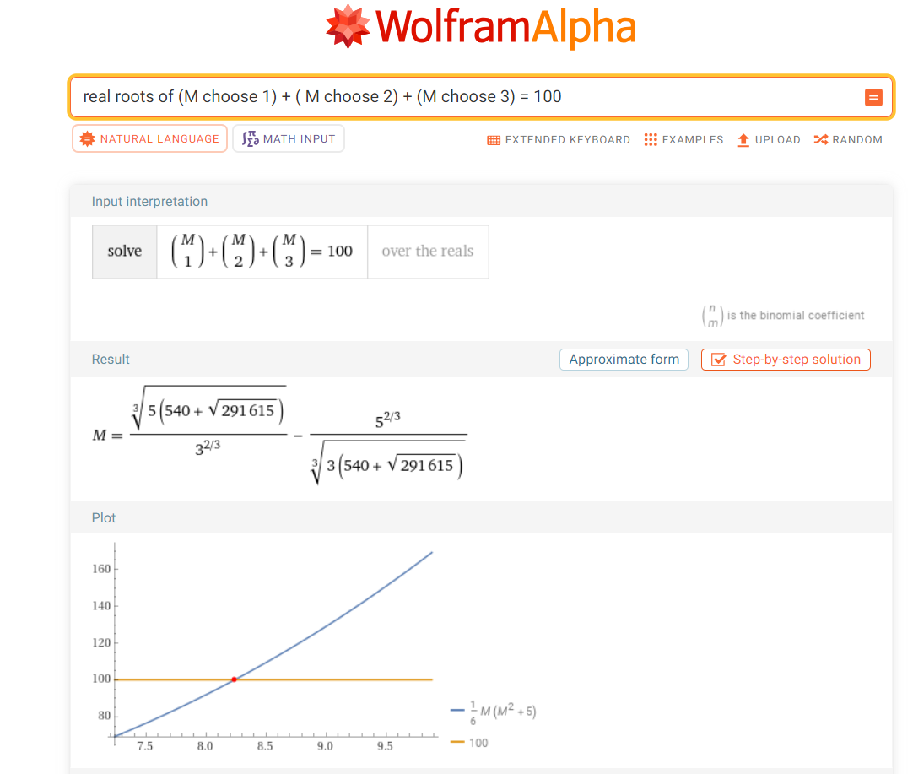
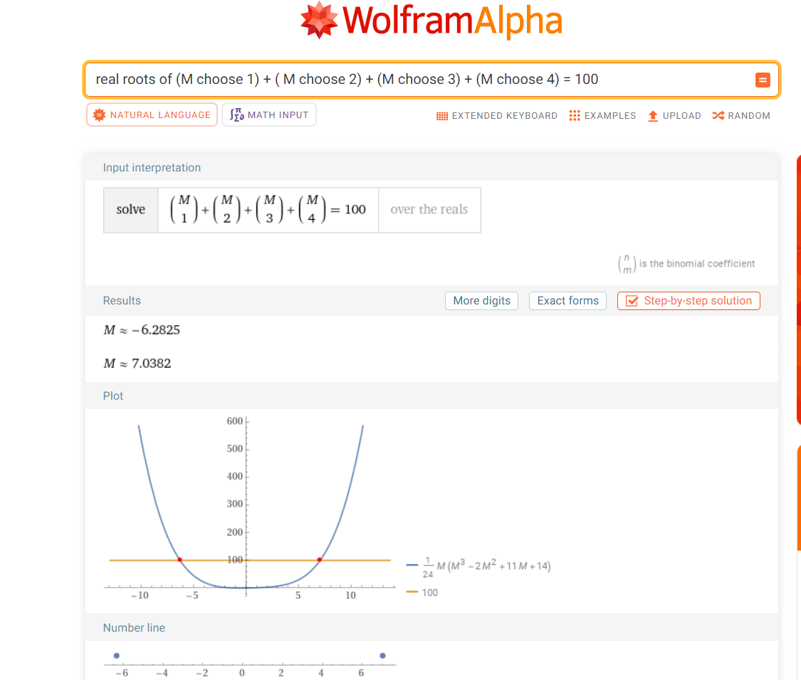
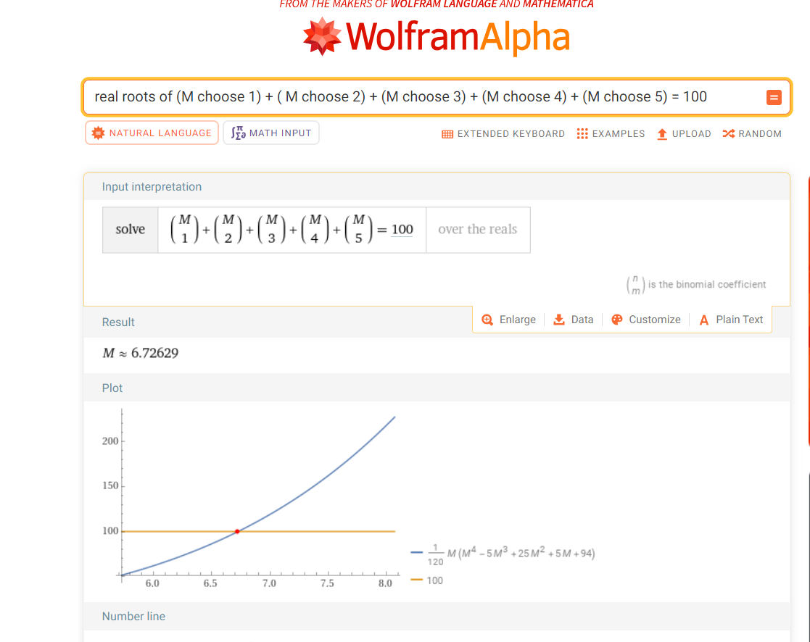
Examples for k= 3, 4, 5

Slide 11

Quick look at the Polynomial-in-hand
$$\sum_{j=1}^{k}{\left(\begin{aligned}m \\ j\end{aligned}\right)}=n$$
For Larger n, Note integral coefficients…
We see Diophantine equations, binomial symmetry..
Are there real roots? Is it Solvable?
Not sure for your n or m or k?
Galois Theory applies & attempt to see if there is a solution, possibly ! Approximate algorithms may work as well..

Slide 12

Variations and Extensions
You may know $m$, $k$but not $n$ etc. Clearly two entities must be known.
$n$ varies with time or depending on result on a floor you change $n$ ( Network loading )
Continuous scenario. What if height of each floor ‘dx’ is infinitesimal? Then $n → ∞$. Binary search is the way…
Balls, meaning of ‘glass breaking’ is ‘loosely defined’ for enough applications.
e.g. ignore some floors if glass breaks $f_{1}$, $f_{2}$ etc. there are some spare balls those floors!. Break condition is if > something or less than etc. Leading to applications…

Slide 13
Applications, A lot!
Here is Four more besides Network Loading…
Real Blackhole Event Horizon advance measure…
Data stream with long sequence of 0s starting ‘somewhere’ and 0s after.
Malicious ‘Node’, eating Web Crawlers – called Blackholes, in Byzantine Networks
Minima search in Convex models

Slide 14
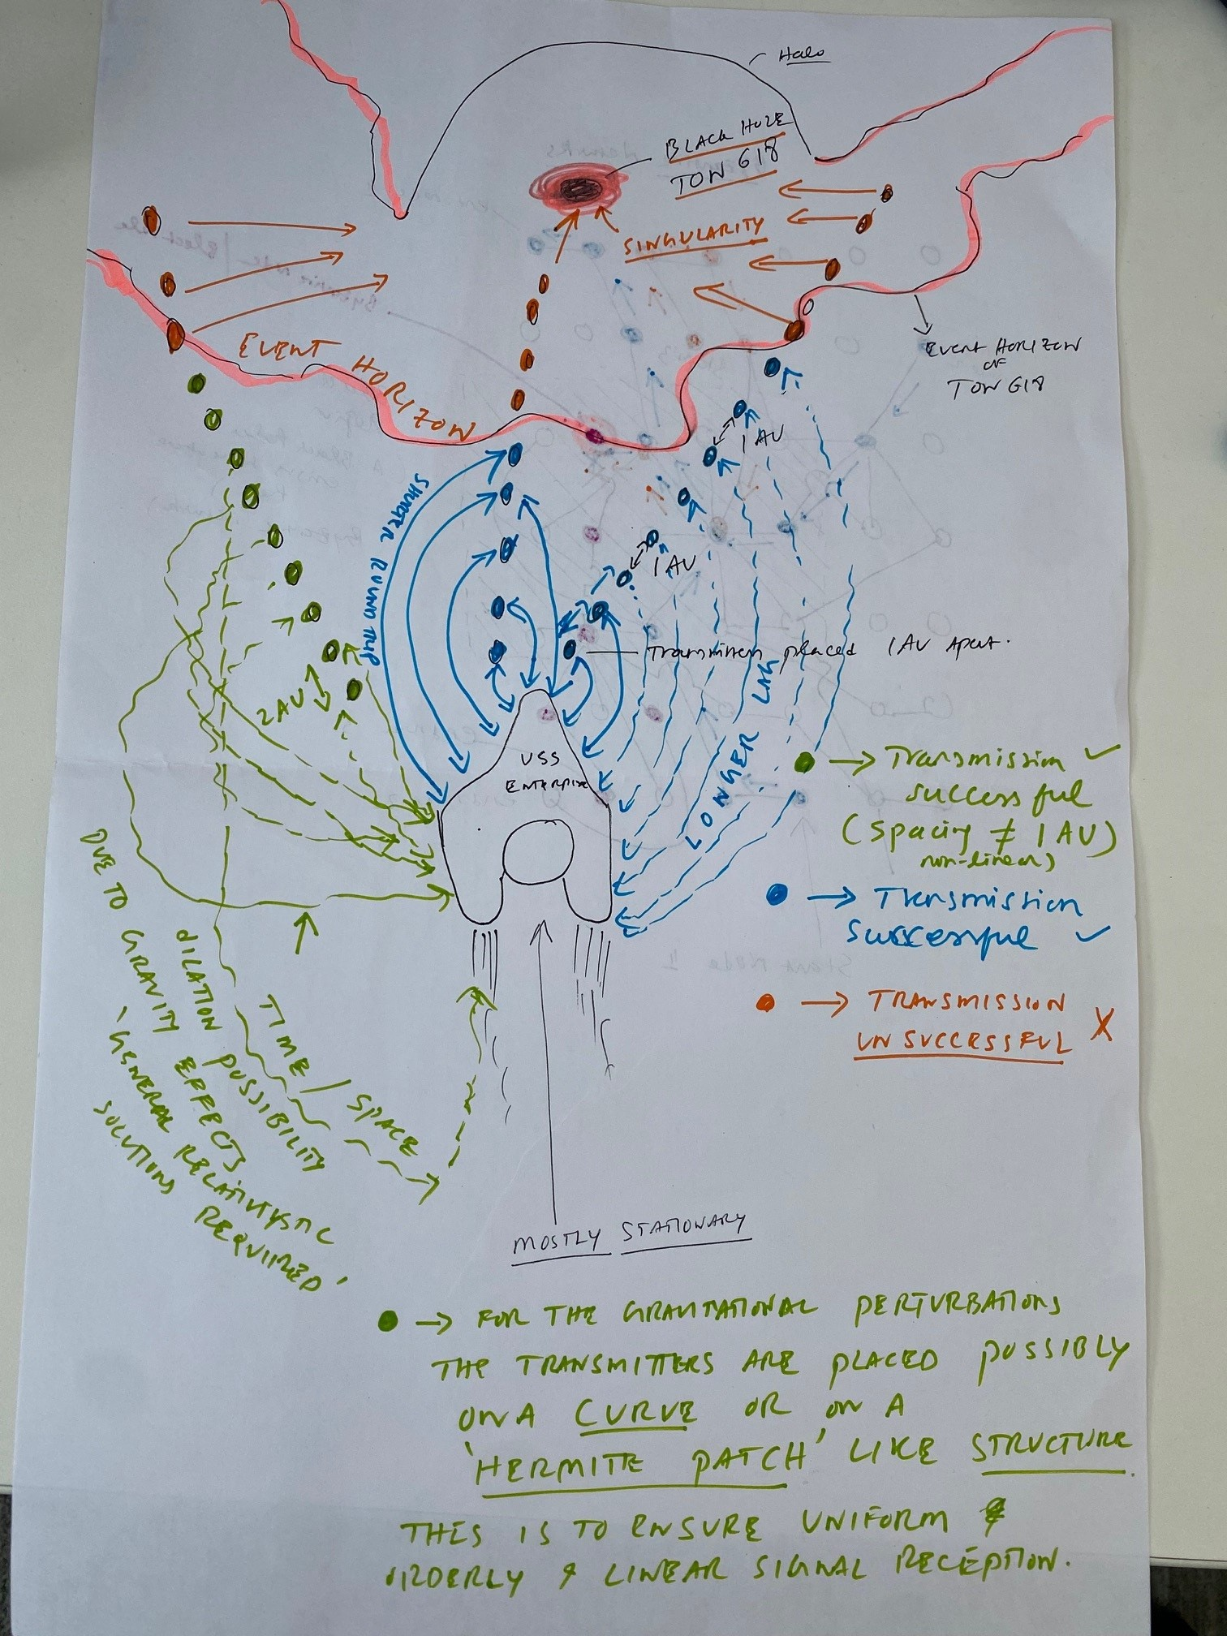
BH

Slide 15

DataStream with infinite stream of 0s
Data stream looks like this..
10111111111110110111….000000000000000000000000000000…
Algorithm:
Index of Some start bit s that was set is known…and some n’th bit after is 0. We want to find out the starting of the 0s
We want to set say, n = 100000 Break condition. No more than m tests/sampling.
Break condition : At $p_{i−1}$if bit is not set (0) calculate $p_{i}$. If bit is set
s=$p_{i−1}.$Calculate $p_{1}$ again. Etc.

Slide 16
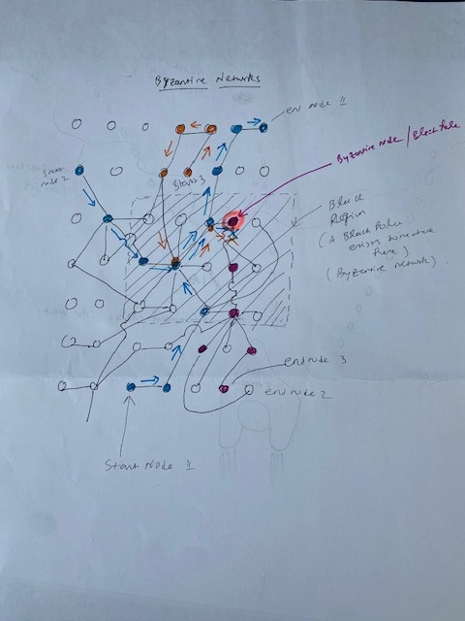
B

Slide 17
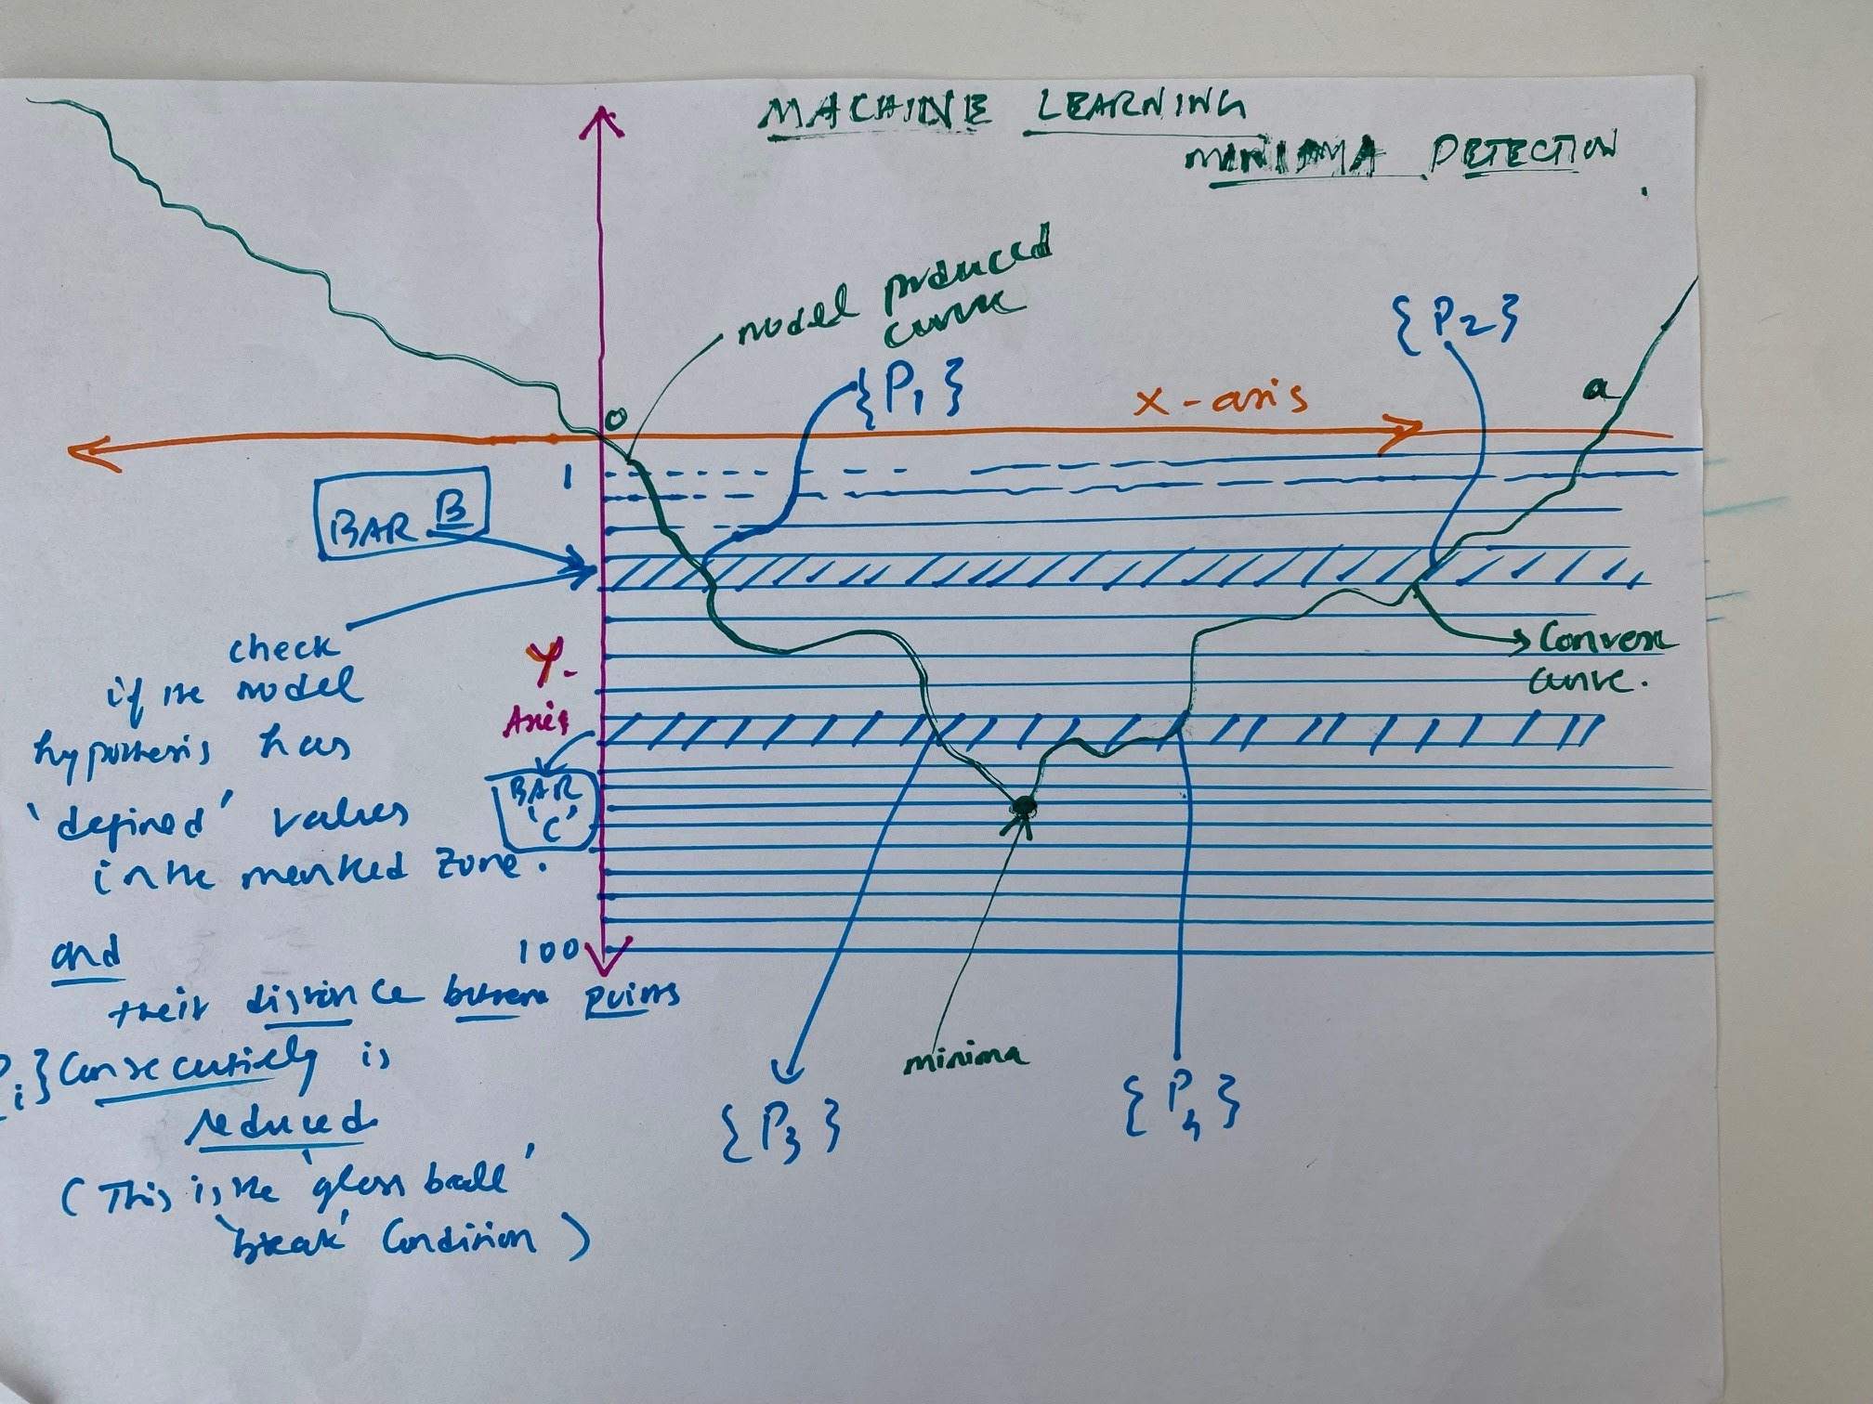

Slide 18
Thank You!

